Slide 1
App Trader
Captain SQL
Notes:
Hi we are captain SQL and this is the app trader recommendation app presentation - our team members are Timothy Yost, Jason Thompson, Larry Scott, Michael Weston, and Mel Quarles.

Slide 2
Assumptions
Apps under $1 cost $10k, if over $1 cost is 10x price
All apps earn the same average revenue each month: $5,000
All apps will cost $1,000 to market, across both stores
Higher rated apps have a higher life expectancy
Notes:
Our assumptions are important for how we created our recommendation list. We are presented with several assumptions which will form the basis of our recommendations. One assumption is that all of the apps $1 or less will cost $10,000 for apptrader to purchase. Anything costing the customer over a dollar in the app or play store, will cost us exponentially more to purchase. Another assumption is that all apps will bring in $5k in revenue on average per month, regardless of price. For this reason we went ahead and filtered out any apps over $1 in price. Since all the apps are bringing in the same revenue it only makes sense to filter out more expensive ones that will cut into our profit.
A third assumption is that all the apps will cost $1,000 to market - even if that are available in both app stores that is the baseline cost for marketing
Also higher rated apps = a higher life expectancy. In that the higher an app is rated the longer it is expected to last

Slide 3
Strategy
Apps available in both stores = best ROI
High review count = high number of users, more in-app purchases
High rating, combined with high review count = longevity
Diversification of genres and demographics, risk management
Notes:
Based on the outlined assumptions, our strategy has been to focus on apps available in both app stores, since we get a higher return on investment of marketing costs. IE, for the same marketing cost, more people will see the app if it is available in both markets.
Also, we focused on apps with a high review count, because a high number of reviews indicates a large user base. More users means more potential for in-app purchases, which increases our profit.
Additionally, we want to focus on apps that are expected to last a while. Since we are pulling revenue from in-app purchases, rather than initial purchase of the app, we want apps that we can foster a loyal customer base over a long time.
Finally, we want to diversify the types of apps we choose so we don’t put all our eggs in one basket. We can diversify based on a number of factors, such as genre, age or content rating, and growth potential.

Slide 4
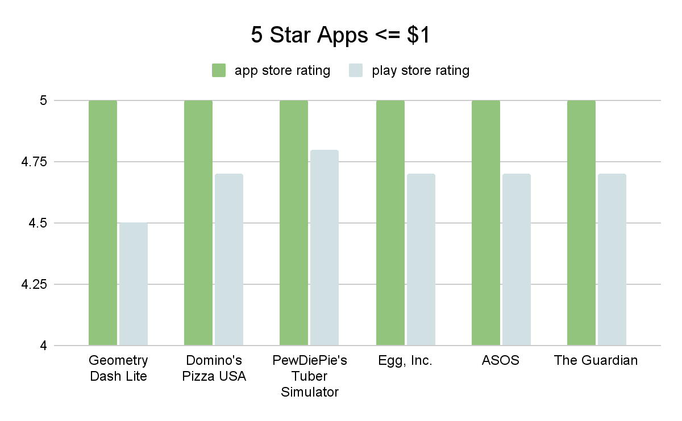
Notes:
So in order to achieve this strategy we first joined the tables based on shared name, so we could get a list of apps available in both stores. Then we filtered by price so that we only consider apps of $1 or less. Finally we filtered for ones with a rating of 4.5 or higher in both stores. This gave us a list of 75 top performing apps which we can choose from. The top rated apps are listed above. There were only 6 apps in our list that had a user rating over 5 stars, about it is worth noting that these were only 5 stars in the app store, not the play store, since the rating scale is less granular on the apple platform. We also noted that the review counts for these apps were pretty low compared to some of the other apps in the list. It is logical to assume that an app with way more reviews that still keeps a high rating is a much more valuable and stable app than one with much fewer reviews.

Slide 5
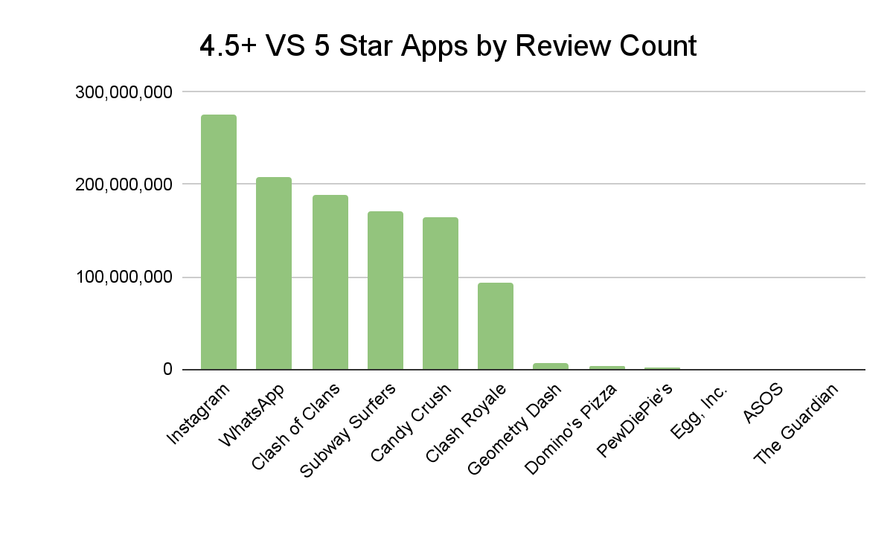
Notes:
To illustrate the point about review counts, compare the 5 star apps on the right with the a list of highest rated, high review count apps on the left. Note that all of these apps are rated at 4.5 or higher in both stores, so they represent relatively long lived and high value apps. However the ones on the left have a much higher review count. The difference in the scale of users is staggering. Additionally, it is worth point out that more reviews means more users and since app trader's profit is directly tied to in-app purchases, we figured it may be worth looking at some of the apps with higher review counts, rather than limit ourselves by 5 star rating only.

Slide 6
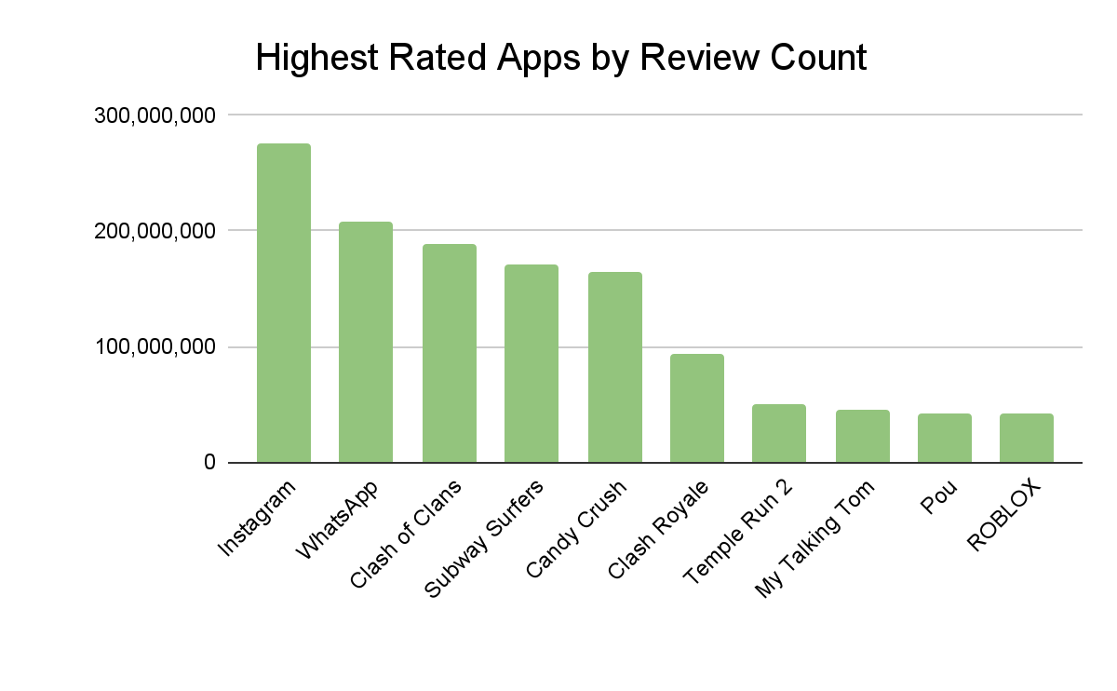
Notes:
After taking into account number of users, the following is a recalculated list of the apps of 4.5 rating or higher with the highest review count prioritized. These would all be excellent choices for apptrader to invest in. However, we would also like to suggest a possible alternative strategy of diversification. To avoid putting all our eggs in one basket we decided to consider choosing apps from a variety of genres and content ratings.

Slide 7
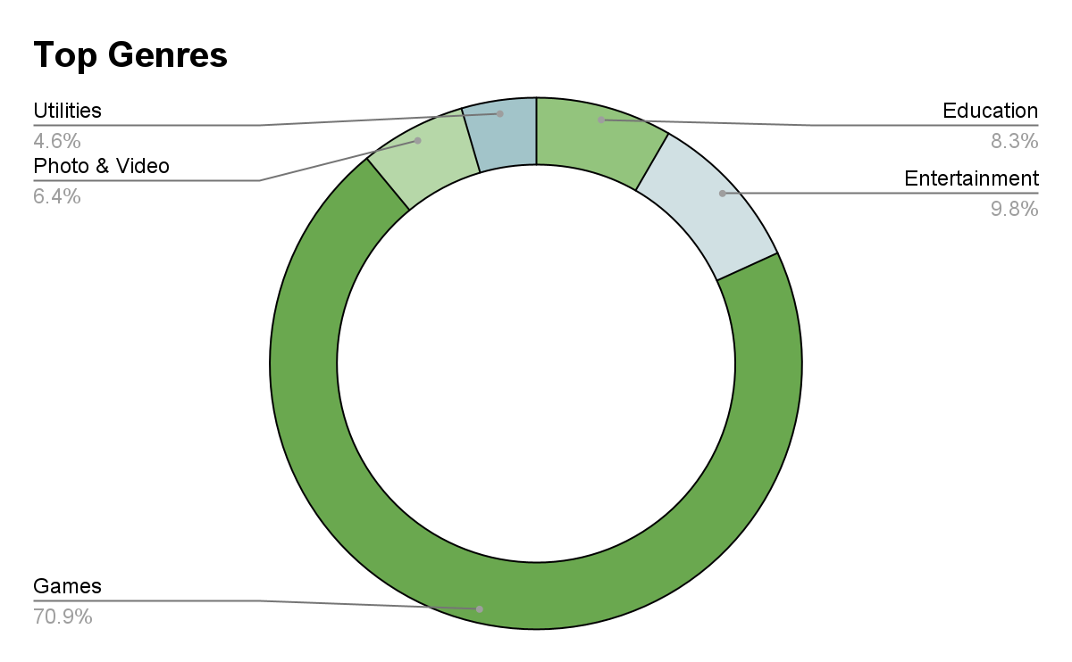
Highest Rated/Reviewed Apps in Non-Game Genres
App Name | Genre
Puffin Web Browser | Utilities
ClassDojo | Education
Instagram | Photo & Video
YouTube Kids | Entertainment
Notes:
Of the original curated list of top rated apps, we looked first at the distribution of genres across the set and noticed that games overwhelmingly comprise the list of top rated apps under $1. So we decided the final list should include a majority of apps that are games, but that we should also pick a few non-game apps to ensure we are targeting different types of app users. We identified the next four highest genres in the list and chose one app from each. These will appear in our final list of recommendations. We did have to tweak our original list a bit because some of the genres were not represented in the highest ratings, so some of these include slightly lower rated apps but they are still all 4.0 or above in both stores.

Slide 8
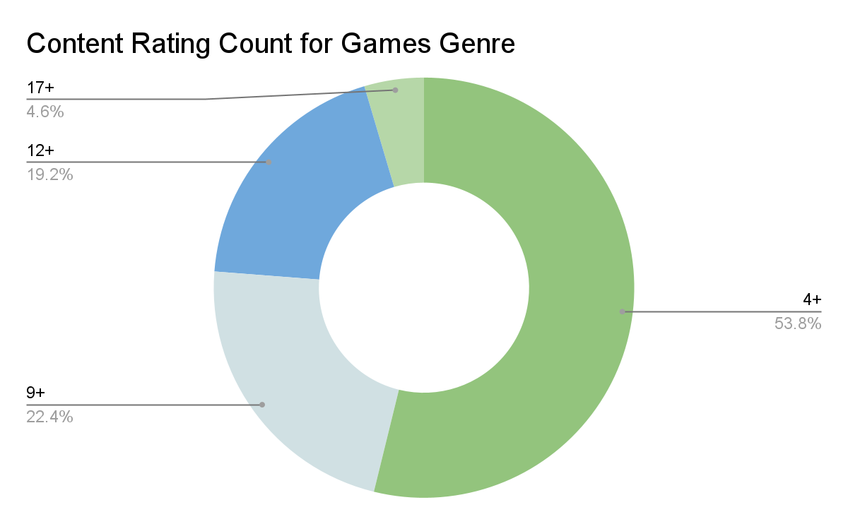
Highest Rated/Reviewed Apps in Varied Content Rating Groups
App Name | Content Rating
Shadow Fight 2 | 12+
Clash Royale | 9+
Clash of Clans | 9+
Score! Hero | 4+
Fishdom | 4+
Candy Crush Saga | 4+
Notes:
Next we had to decide how to choose which gaming apps to highlight. For the games we wanted to diversify based on content-rating to make sure the apps represent a wide age range of users. Of the original filtered list the chart here represents the distribution of content ratings. As you can see the majority are games for age 4+ but a healthy number are also included as 12+ and 9+ games. 17+ games seem less prominent so we did not include any of these.

Slide 9
Alternative Recommendation List
App Name | Genre | Content Rating | Star Rating app / play | Review Count
Clash of Clans | Games | 9+ | 4.5 / 4.6 | 188,082,001
Candy Crush Saga | Games | 4+ | 4.5 / 4.4 | 163,725,694
Clash Royale | Games | 9+ | 4.5 / 4.6 | 93,597,982
Shadow Fight 2 | Games | 12+ | 4.5 / 4.6 | 22,159,324
Score! Hero | Games | 4+ | 4.5 / 4.6 | 16,514,212
Fishdom | Games | 4+ | 4.5 / 4.6 | 6,592,091
Instagram | Photo & Video | 12+ | 4.5 / 4.5 | 274,888,221
YouTube Kids | Entertainment | 4+ | 4.5 / 4.5 | 1,995,587
Puffin Web Browser | Utilities | 17+ | 4 / 4.3 | 1,659,470
ClassDojo | Education | 4+ | 4.5 / 4.4 | 551,955
Notes:
So our final recommendation list is based on the diversification strategy we outlined and is an alternative recommendation to the list of apps on slide 5, which was based only on user rating and review count. As you can see most of the apps are highly rated with a high review count, but there are some exceptions based on bringing in more diverse genres and content ratings.

